Slide 1
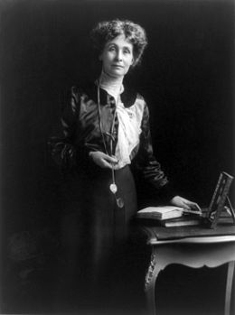
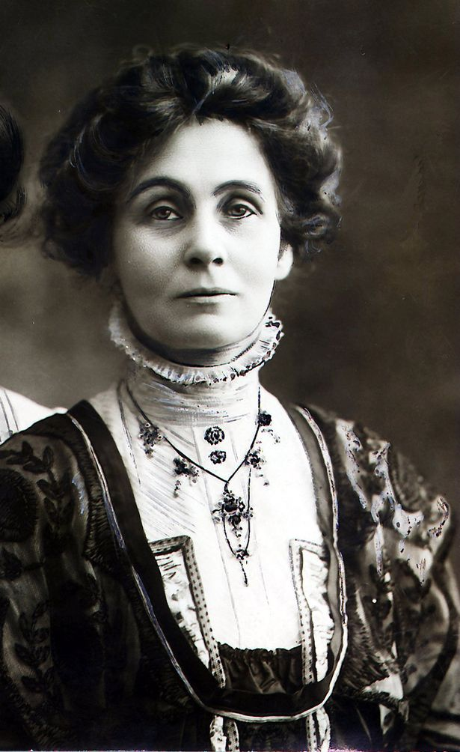
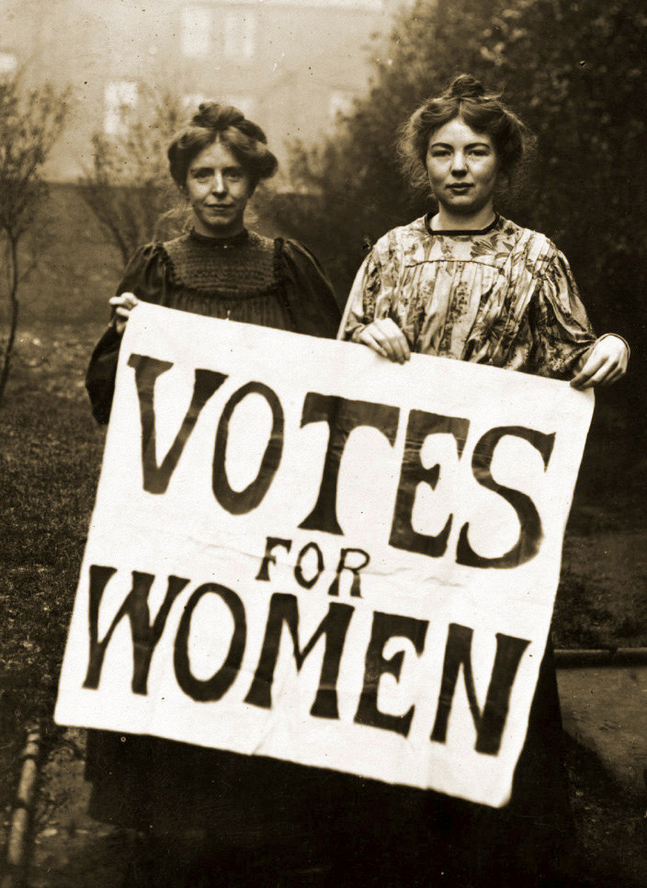
Emmeline Pankhurst and the suffragettes
Presented by Hugo Roussel and Henry Letellier
Notes:
Hugo & Henry

Slide 2
Summary
Emmeline Pankurst
Who was she?
What did she do?
Her overall life
Her personal life
The suffragettes
A bit of context
Who were the suffragettes?
How did they do it?
King horse at the Derby
Accident or intentional?
The impact of world war I
Key dates
Lessor known facts
When did women get the right to vote in France?
Source
Notes:
no body

Slide 3
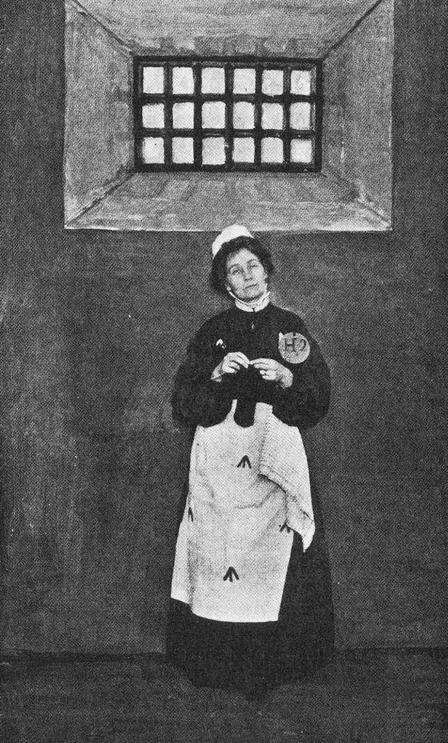
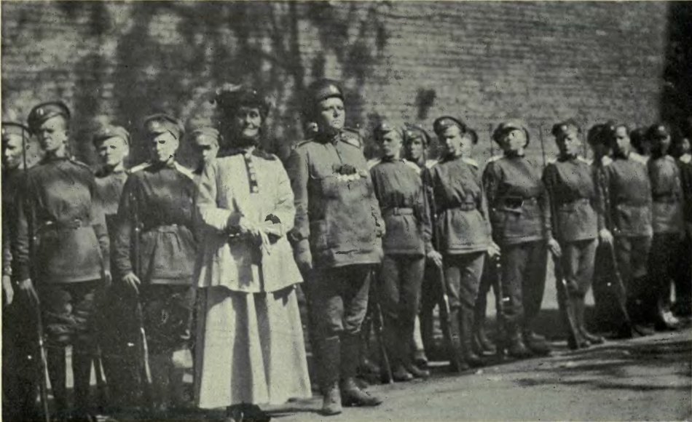
Emmeline Pankhurst ‘Deeds not words’
Notes:
Hugo

Slide 4
Who was she?
Date of birth: 15 July 1858 in Manchester
Date of death: 14 June 1928
Maiden name: Emmeline Goulden
Leading British women’s rights activist
Notes:
Henry

Slide 5
Her background
Early life
One of 10 children
Grew up in a politically active family
Her Parents were:
Abolitionists
Supporters of women’s rights
Notes:
Henry

Slide 6
Her personal life
Marriage:
1878 To Dr. Richard Pankhurst, a Lawyer
She helped her husband with his political career
Supported a lot of radical causes for women’s suffrage
Had five children Three girls: Christabel, Sylvia, Adela Two boys: Frank, Harry
Notes:
Hugo

Slide 7
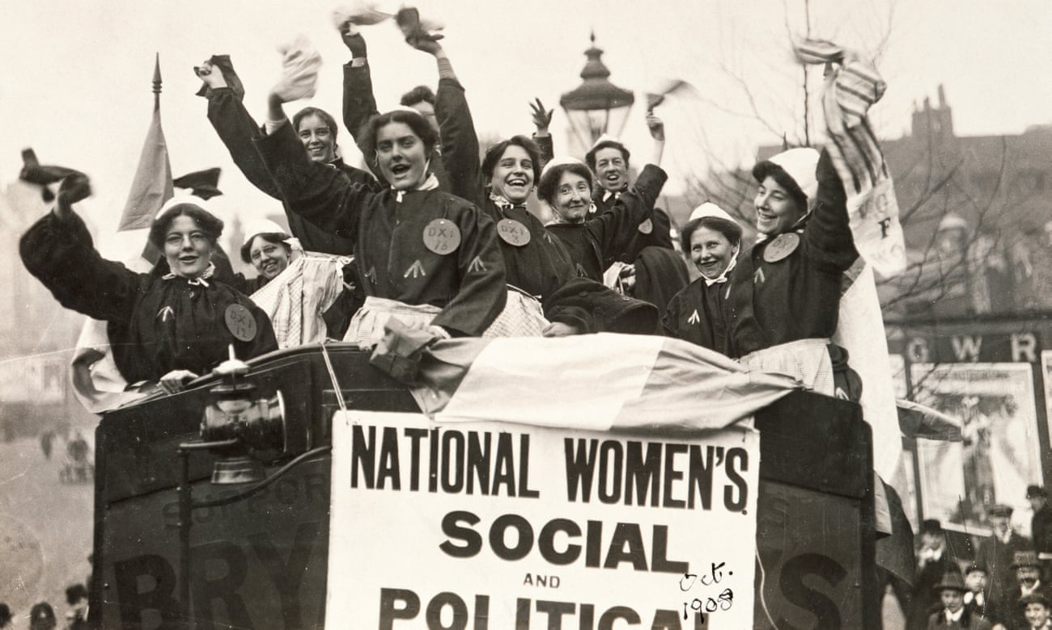
The suffragettes
Notes:
Hugo

Slide 8
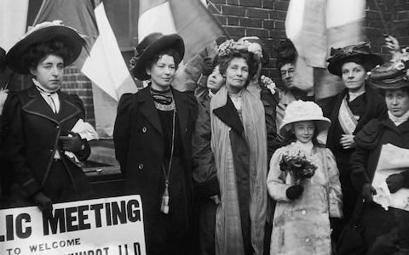
Who were the suffragettes?
Generally Educated women from middle and upper classes but also included women from working class backgrounds.
The women-only WSPU, became the most notorious of the various groupings campaigning for the vote
Notes:
Hugo

Slide 9
What did she do?
Pankhurst campaigned to get the right for all woman to vote
1903 she wanted things to happen faster so she founded the Women’s Social and Political Union (WSPU)
The ‘Daily Mail’ named WSPU the suffragettes as a derogatory term in 1906
The WSPU movement adopted the colours purple, white and green for use in their campaign
Notes:
Henry

Slide 10
A bit of Context
“suffrage” means right to vote in political elections.
1867 Reform Act extended the right for all men over 21 to vote.
Many people did not believe it was right for women to have the vote.
Queen Victoria described women’s suffrage as ‘a mad, wicked folly’.
Notes:
Henry

Slide 11
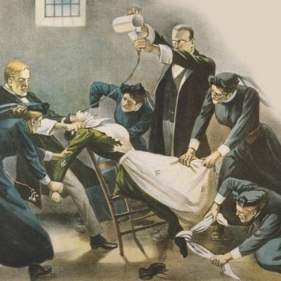
How did they do it?
Emmeline realised - more active approach was needed to win women the vote:
Women deliberately broke the law to gain publicity: disrupted meetings, chained themselves to the railings of Buckingham Palace, smashed windows and set post boxes alight.
Many were arrested and put in prison - went on hunger strike as they wanted to be treated as political prisoners and not criminals
The police responded by force feeding them. This was degrading and injured women’s health - a public outcry. The Cat and Mouse Act of 1913 enabled the police to release women in poor health from prison and then re-arrest them when they recovered.
Notes:
Henry

Slide 12
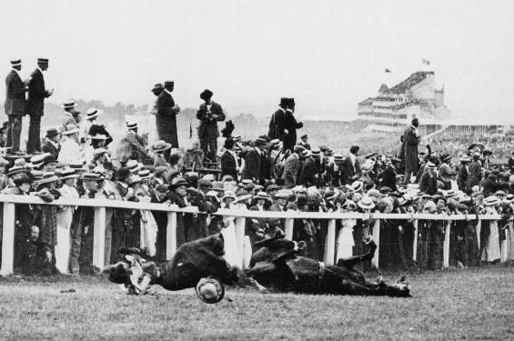
King’s horse at the Derby
Notes:
Hugo

Slide 13
Accident or intentional?
The Movement acquired first martyr in 1913: Emily Wilding-Davison threw herself under the King’s horse during the Derby.
Recent research reveals that she had intended to attach a flag to the horse and not be killed by it
Her death focused public attention on the Suffrage Movement
Notes:
Henry

Slide 14
The impact of world war I
1914, Emmeline suspended the campaign and instructed the suffragettes to focus their help on the war effort
Result: the crucial role played by women during the First World War, many of whom entered the workforce, fundamentally changed the perception of women in society
This persuaded the Prime Minister David Lloyd George to grant female householders over thirty the vote in 1918
Notes:
Henry

Slide 15
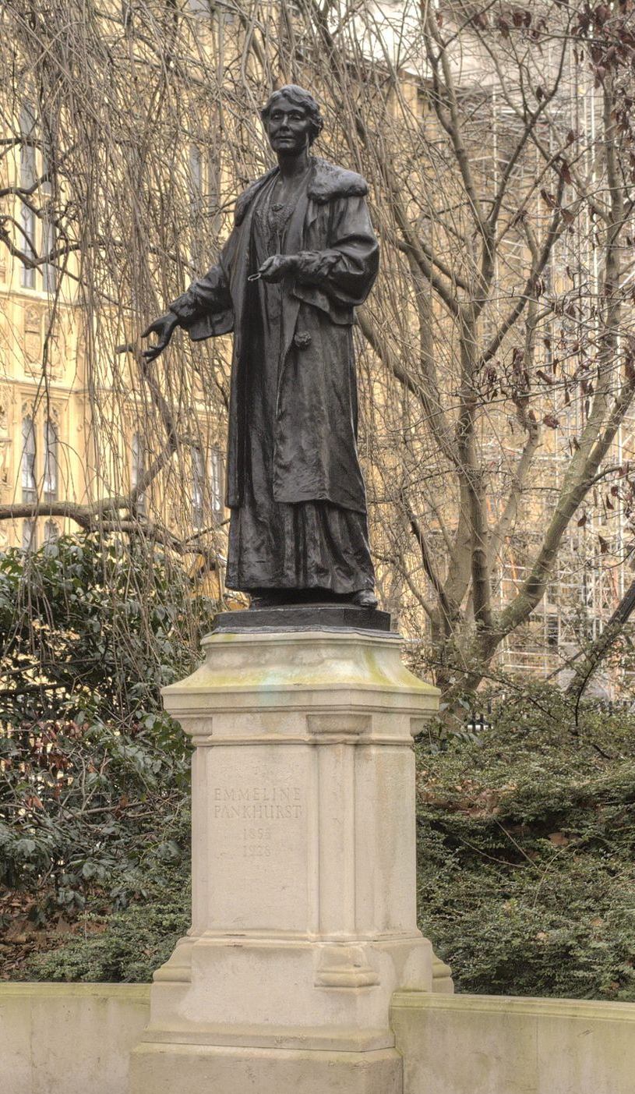
Key dates
1918 women householders over 30 get the vote and all men over 21
1919, Nancy Astor becomes first female Member of Parliament
After the WWI Pankhurst transformed the WSPU to the Women's Party, with the aim to promote women's equality in public life
Pankhurst, concerned about Bolshevism, joined the Conservative Party
1927 She was selected as a Conservative candidate
She died on 14 June 1928, only weeks before Representation of the People Act (1928) which finally gave all women over the age of 21 the right to vote
Notes:
Hugo

Slide 16
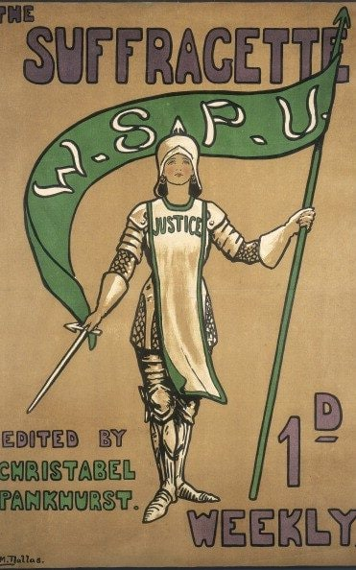
Lessor known facts
Men played a key role too, despite the most famous faces of the Suffragette movement being women, there were also several men, who fought alongside them to secure a woman’s right to vote.
Notes:
Henry

Slide 17
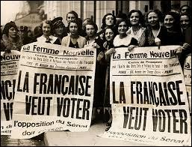
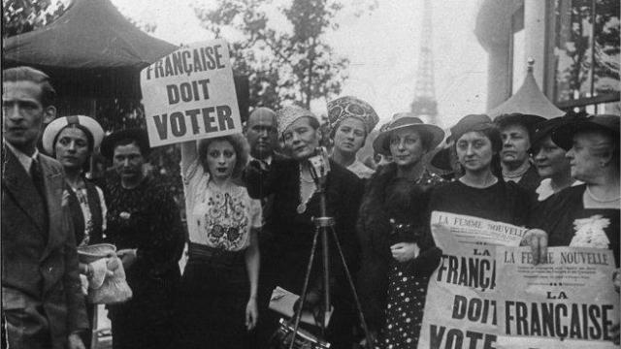
When did women get the right to vote in France?
In April 21, 1944 after the second WWII
Well after the English.
Notes:
Hugo

Slide 18
Source
YouTube video: https://www.youtube.com/watch?v=wVrlLKAR1S0
The suffragettes:
https://news.sky.com/story/the-suffragettes-the-women-who-risked-all-in-their-battle-to-vote-11233478
https://www.historylearningsite.co.uk/the-role-of-british-women-in-the-twentieth-century/suffragettes/
https://www.natgeokids.com/uk/discover/history/general-history/suffragettes-facts/
https://www.theguardian.com/society/2013/may/26/emily-davison-suffragette-death-derby-1913
Emmeline Pankhurst:
http://www.bbc.co.uk/history/historic_figures/pankhurst_emmeline.shtml
PowerPoint images:
1^{rst} image 1rst slide of the PowerPoint: https://upload.wikimedia.org/wikipedia/commons/thumb/6/63/Emmeline_Pankhurst2.jpg/260px-Emmeline_Pankhurst2.jpg https://i2-prod.mirror.co.uk/incoming/article1916136.ece/ALTERNATES/s615b/Emmeline-Pankhurst-sufragette-who-fought-for-the-right-for-women-to-vote.jpg , 2nd image 1rst slide of the PowerPoint : By Unknown - http://www.hastingspress.co.uk/history/sufpix.htm, Public Domain, https://commons.wikimedia.org/w/index.php?curid=70388851
3rd slideshow image 1: https://upload.wikimedia.org/wikipedia/commons/0/0c/Emmeline_Pankhurst_in_prison.jpg
3rd Slide image 2: https://en.wikipedia.org/wiki/Emmeline_Pankhurst#/media/File:Batall%C3%B3n-muerte-rusia--insiderussianrev00dorrrich.png
9th slideshow : https://i.guim.co.uk/img/media/dfa065d071d1693510b2605d7fc983695a97e547/104_0_5289_3175/master/5289.jpg?width=1300&quality=85&auto=format&fit=max&s=69f1a5504ed37bed979ca27392647652
11th slideshow: https://www.telegraph.co.uk/content/dam/women/2017/06/21/Emmeline-Pankhurst_trans_NvBQzQNjv4BqHaZ8JMGQ_nOZ1URPL9FaE6Cx7b-Q6FcLBM_ipaN5SpA.jpg?imwidth=450
12th slideshow: https://images.immediate.co.uk/volatile/sites/7/2018/01/AYKA22FORCEFEEDING_mod-8d4d33e.jpg?quality=90&resize=620,413
13th slideshow: https://upload.wikimedia.org/wikipedia/commons/7/7c/Emily_davison_killed_1913.jpg
16th slideshow: https://upload.wikimedia.org/wikipedia/commons/thumb/8/8d/Emmeline_Pankhurst_statue_Victoria_Tower_Gardens.jpg/300px-Emmeline_Pankhurst_statue_Victoria_Tower_Gardens.jpg
18th slideshow: https://images-na.ssl-images-amazon.com/images/I/81s6yvk48%2BL._SY606_.jpg
19th slideshow: https://www.histoire-pour-tous.fr/images/articles/dossiers/histoire-de-france/vote_femmes.jpg , https://www.ouest-france.fr/sites/default/files/styles/image-640x360/public/2015/04/21/il-y-71-ans-les-femmes-obtenaient-le-droit-de-vote.jpg?itok=bceYejWb ,
Notes:
no body

